Slide 1

Human Resource System 3.0
Developed by : ESS – E-Service Development Team
©2019 Nizwa College of Technology

Slide 2

Presentation Agenda
01
System Objective
Information about the system
02
System Contents
System flow and overview of the system features
03
Project Demo
Actual demo of the system .
04
Question & Answer
Get audience comments, suggestions.

Slide 3

About the HR System
NCT HR System is part of E-Services that’s used in Storing Employees Data, Managing Leave Application, and Keeping Track of Attendance Records.

Slide 4
Current System (2.0) Contents
Staff Information Repository
All Staff Profile such as employment history, Educational Background, Family and Contact details
Leave Applications
Filling and Approving of Short and Standard Leave, Adding of Interval and Emergency Leave Balance
Attendance
Viewing of Staff Attendance from biometric device.
Staff Clearance
Clearance Application and Approval

Slide 5
New Contents in version 3.0
Overtime Module
Heads can now apply the overtime work under their section of department. This is embedded and linked in the attendance system.
Delegation of approvals and roles
Such roles can now be delegated to other heads and staff. Approval/acceptance process applies.
User Access Page Restrictions
Dynamic user type permission to system access.
Leave Settings
Process of approval can be change dynamically at any time using this module

Slide 6
New Contents in version 3.0
Dynamic Report Generation
Reports will be available based on user requirements. All reports will be dynamic based on parameters given by the user. (Status: On queue. Reason, no sample forms and reports templates yet.)
Clearance module, new approach and process
This will be one of the topic in the meeting after presentation.
Documents Module
Airfare compensation, Civil ID renewal documents, Visa renewals, etc. will be available in the system. (Status: On queue, Reason, no sample forms and templates yet, process is not clear to the team.)
Exit Interview Module
This is to be integrated in the clearance system. This module needs
Deliberation and discussion among the team and HR Department.

Slide 7
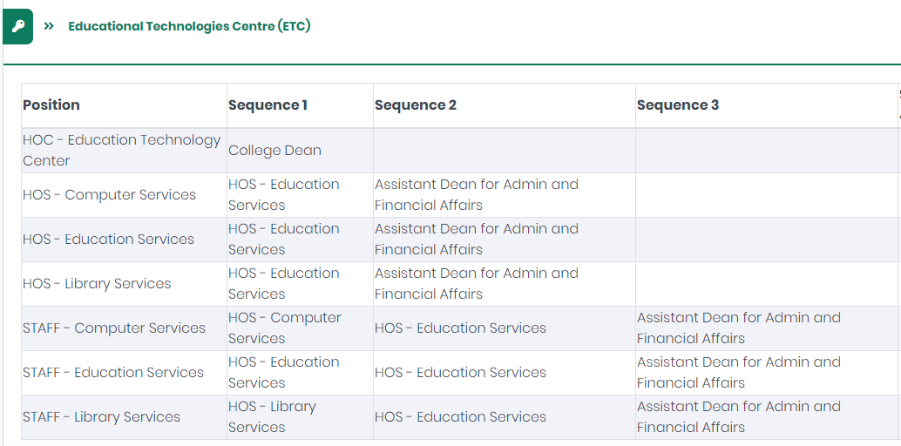
Data Requirements in version 3.0
Staff Position and Approvals
The team will provide a template to the HR Department to be filled out and send back to the team for the live data. See example below:

Slide 8
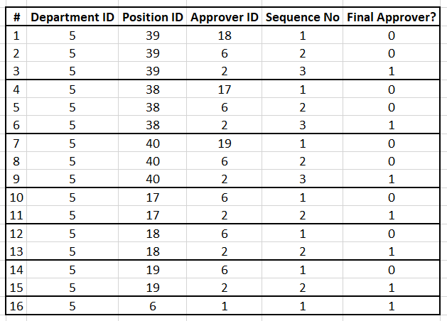
Data Requirements in version 3.0
Note:
This is a sample data for the ETC Department. All data are in numeric form and each corresponds to a value like for example row 1:
Position ID 39 – Staff – Education Services
Approver ID 18 – HoS – Education Services
Sequence No 1 – First Level of Approval
Final Approver 0 – Not yet the Final Approver
Row 12 as example:
Position ID 18 – HoS – Education Services
Approver ID 6 – HoC – ETC
Sequence No 1 – First Level of Approval
Final Approver 0 – Not yet the Final Approver
Row 13 as example:
Position ID 18 – HoS – Education Services
Approver ID 2 – ADAFA
Sequence No 2 – Second Level of Approval
Final Approver 1 –Final Approver

Slide 9
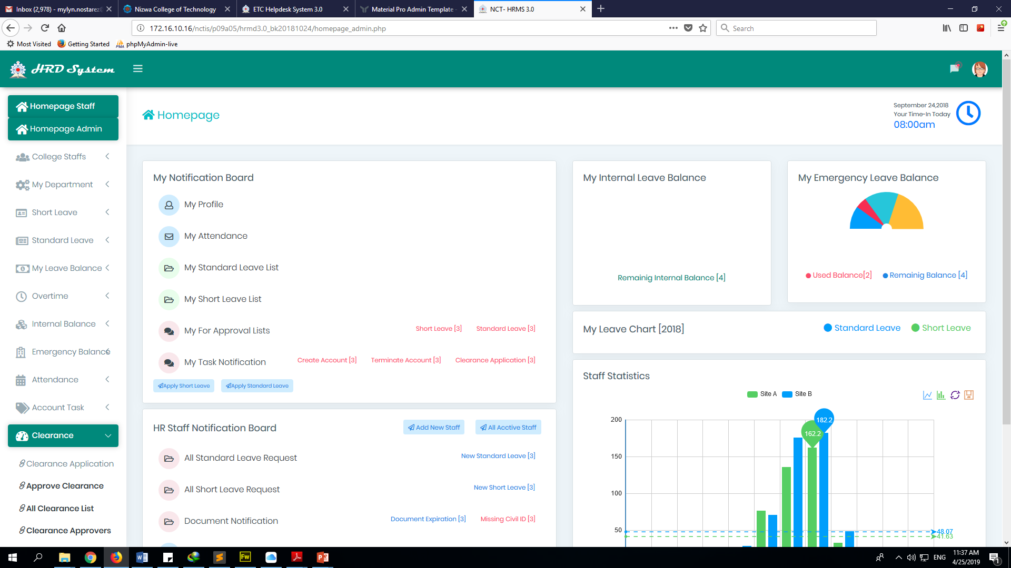
System Demo

Slide 10
Question & Answer

Slide 11
Human Resource System 3.0
Thank You!!!
Developed by : ESS – E-Service Development Team
©2019 Nizwa College of Technology

